Slide 1
CSE101-Lec#35
Self Referential Structures
HARWANT SINGH ARRI

Slide 2
Introduction
Dynamic data structures
Data structures that grow and shrink during execution
Linked lists
Allow insertions and removals anywhere

Slide 3
Self-Referential Structure
A structure which contains a pointer to itself is called a self-referential structure.
A structure cannot contain instance of itself.
A self referential structure is used to create data structures like linked lists, stacks, etc. Following is an example of this kind of structure:
struct struct_name { datatype datatypename; struct_name * pointer_name; };

Slide 4
Self-Referential Structures
Self-referential structures
struct node { int data; struct node *nextPtr; }
nextPtr
Points to an object of type node
Referred to as a link
Ties one node to another node

Slide 5
A variable of type struct car cannot be declared in the definition of struct car.
However, pointer to car may be included.
Struct car{
char name[20];
struct car newCar; // wrong
struct car *newCarPtr; // right
};

Slide 6
Linked Lists
Linked list
Linear collection of self-referential class objects, called nodes
Connected by pointer links
Accessed via a pointer to the first node of the list
Subsequent nodes are accessed via the link-pointer member of the current node
Link pointer in the last node is set to NULL to mark the list’s end
Use a linked list instead of an array when
You have an unpredictable number of data elements
Your list needs to be sorted quickly

Slide 7
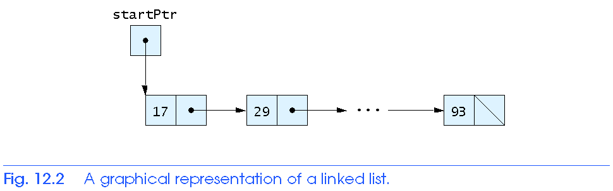
Linked Lists

Slide 8
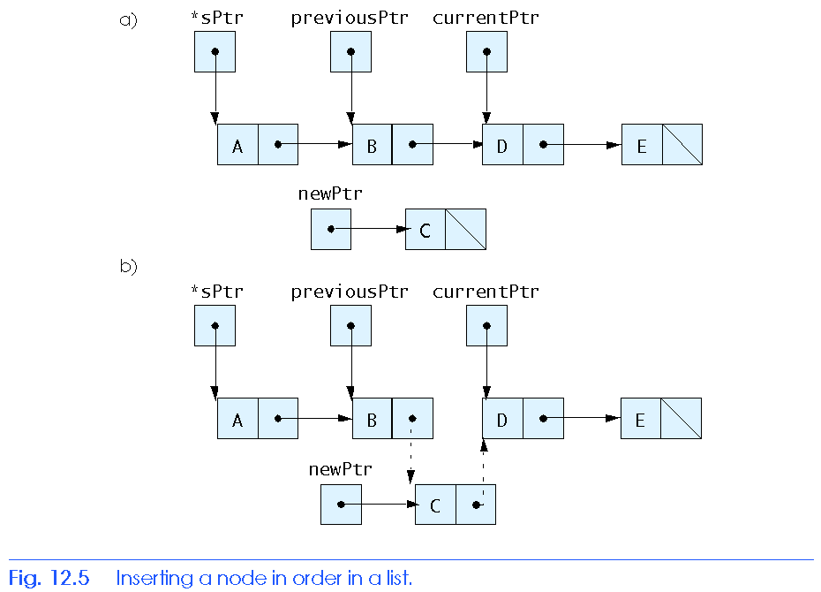
Linked Lists

Slide 9
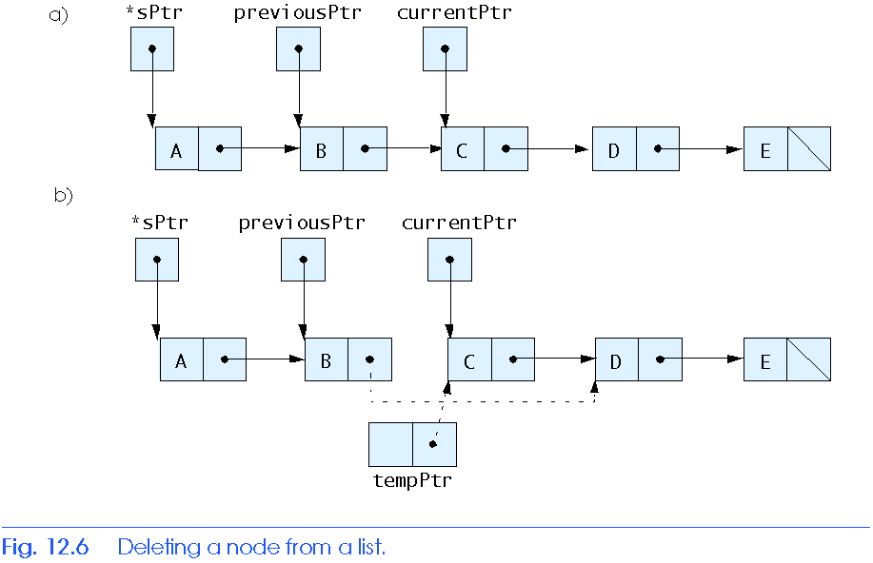
Link List

Slide 10
#include <stdio.h>
struct link //one element of list
{
int data; //data item
link* next; //pointer to next link
}*first;
void additem(int d); //add one link
void display(); //display all links
void additem(int d) //add data item
{
struct link *newlink;
newlink->data = d;
newlink->next = first;
first = newlink;
}
Program of insertion at beginning in the link list

Slide 11
Void display()
{
struct link* current = first; //set ptr to first link
while( current != NULL ) //quit on last link
{
printf(“%d\n”, current->data);
current = current->next;//move to next link
}
}
main()
{
struct link li; //make linked list
additem(25); //add four items to list
additem(36);
additem(49);
additem(64);
display(); //display entire list
return 0;
}
Program of insertion at beginning in the link list

Slide 12
Next Class: Nested Structure Union

